Slide 2
What is and Where Might We Use Time Series Data?
Greg Kuhlemeyer

Slide 3
Here is quintessential Time Series

Slide 4
We can see that temperature is “seasonal”

Slide 5
Time Series Analysis is used for many applications
Economic Forecasting
Sales Forecasting
Budgetary Analysis
Stock Market Analysis
Yield Projections
Process and Quality Control
Inventory Studies
Workload Projections
Census Analysis

Slide 6
Time Series Situations in Finance
Economic Forecasting – forecast future values of leading indicators as a means of forecasting some other dependent variable.
Sales Forecasting – use historical values of sales and any seasonality to forecast revenues that can be used to help forecast cash flows
Yield Projections – use historical data to forecast future interest rates that can be used to project bond prices or risk of insolvency of bank equity

Slide 7
Time Series Situations in Finance
Budget Analysis – Forecast the monthly or quarterly revenues/expenses to estimate the firm budget which might impact capital expenditures and the amount of funds needed to be raised.
Stock Market Analysis – one might forecast the S&P 500 Index value to use in determining if a client will have enough resources to retire successfully.

Slide 8
Univariate versus Multivariate
Univariate time series: Only one variable is varying over time. For example, stock price data collected every second. Therefore, each trade, will only have a one-dimensional value, which is the stock price.
Multivariate time series: Multiple variables are varying over time. This means two or more variables. There are multiple dimensions, one for each axis (a,b,c,d,e etc) and they vary simultaneously over time. See next slide for multiple regression.

Slide 9
Data Smoothing
Data that is collected over time will have random variation.
To try to reduce/cancel the effect due to random variation we use a technique called "smoothing".
This allows us to see the underlying trend and any seasonal/recurrent features.
Two common categories of smoothing methods include:
Averaging: Simple, weighted, moving (see 3-mo and 12-mo next slide)
Exponential Smoothing: previous time points weighted with most impact and each older point has a decreasing weight

Slide 10
Trends using Temperature Data

Slide 11
Multiple Regression Example
y_{i} = a₀ + b₁x_{i1} + b₂x_{i2} + b₃x_{i3} + b₄x_{i4} where
y_{i} = dependent variable: price of XOM (Exxon Mobil)
x_{i1} = interest rates
x_{i2} = oil price
x_{i3} = value of S&P 500 index
x_{i4}= price of oil futures

Slide 12
Forecasting Topics
Qualitative versus quantitative
Naïve forecasts
Moving averages
Linear regression forecasts
Multiple regression forecasts

Slide 13
Qualitative versus Quantitative
Qualitative
Come from experience and “instincts” of veteran business professionals (human judgement)
Allows for quick decisions and/or changes as new information comes forward.
This is the approach used by the President in leading the USA
Often use focus groups, asking opinion/views of employees and/or customers
Very difficult to teach this style/approach and greater errors made without the experiences. Can bias your forecasts and reduce your success/accuracy.
Quantitative
Based on a scientific mathematics approach to evaluating data and making decisions
Using forecasting models based on historical data. Problem is correct or enough data are not available to make the models function most effectively.
Often integrated with statistics to evaluate likelihood which reduces errors and perceived as consistent and very objective.

Slide 14
Naïve Forecasting
General Naïve
Next period value = most recent period value
Appropriate in time series data like FRED (use BUS391 – Week 03 – Final Excel Data.xlsx)
Can be used to compare all other models
Naïve + Drift
Equals previous period plus/minus some amount with each time change (r.g., Federal Reserve announce a 0.25% change in the Fed Funds rate)
Naïve + Seasonal
Forecast period equals the exact same period in the previous matching season (December 2019 used to forecast December 2020) plus an adjustment.
E.g., Grow sales 5% so used December 2019 * (1+.05) = December 2020

Slide 15
Naïve Forecasting – part 2
So assume stocks drift positively 2% per quarter
Looked at average housing starts per quarter and calculated percentage
change to determine the seasonal change in this variable (bit naïve)!

Slide 16
Moving Average Forecasting
Simple smoothing moving average Use the Week 2 data file
Used to smooth out short-term variability (eg., technical analysis or employment)
To forecast, sum up n period values of a variable and divide by n
Compare forecast to moving average
Weighted/Exponential
In a simple average, all pieces carry the same weight. E.g., if average last 10 stock prices, each carries a weight of 10%.
Here, multiply a weighting system (1/100 for oldest, 3/100 next, 5/100 next, etc to 19/100 for most recent) times the variable value

Slide 17
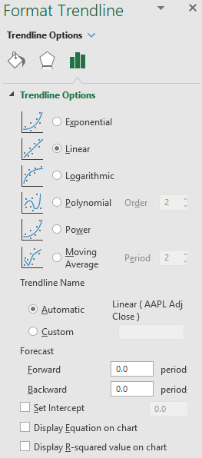
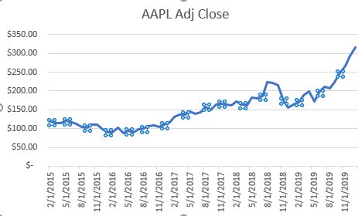
Moving Average Forecasting – Part 2
Create the plot with ALL of the data in Excel and click on the blue data line to reveal the specific data points.
Right click and add a trendline and see the options →

Slide 18
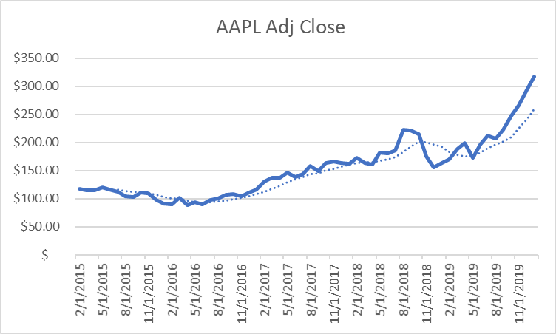
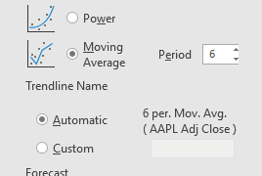
Moving Average Forecasting – Part 3
Choose the Moving Average and choose different numbers of periods.
Watch how the dashed line evolves and how you can see this moving up or down based on recency.

Slide 19
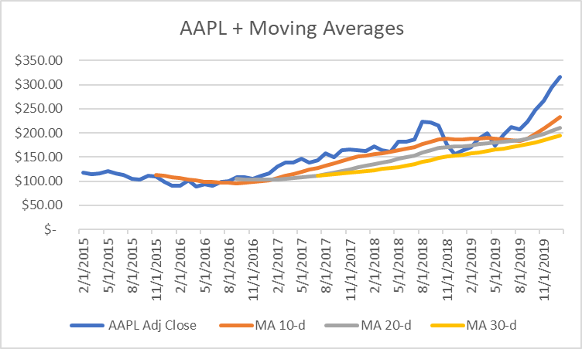
Moving Average Forecasting – Part 4
Go into Excel and starting with the 10th price data, calculate an Average of the preceding 10 prices.
Drag and drop to the last price.
Repeat for 20 and 30 days.
Create a graph like the one on the left.
To forecast a MA, you need to forecast the next periods prices and recalculate the averages

Slide 20
Moving Average Forecasting – Part 5
Look at your previous graphs:
How does the 10-day moving average work as a forecast for the next day price?
How does the 20-day moving average work as a forecast for the next day price?
How does the 30-day moving average work as a forecast for the next day price?
Why? Would you place your career on this type of forecast here?

Slide 21
Moving Average Forecasting – Part 6
Using FRED:
Let us use Unemployment quarterly data and compare naïve to 4 quarter moving average

Slide 22
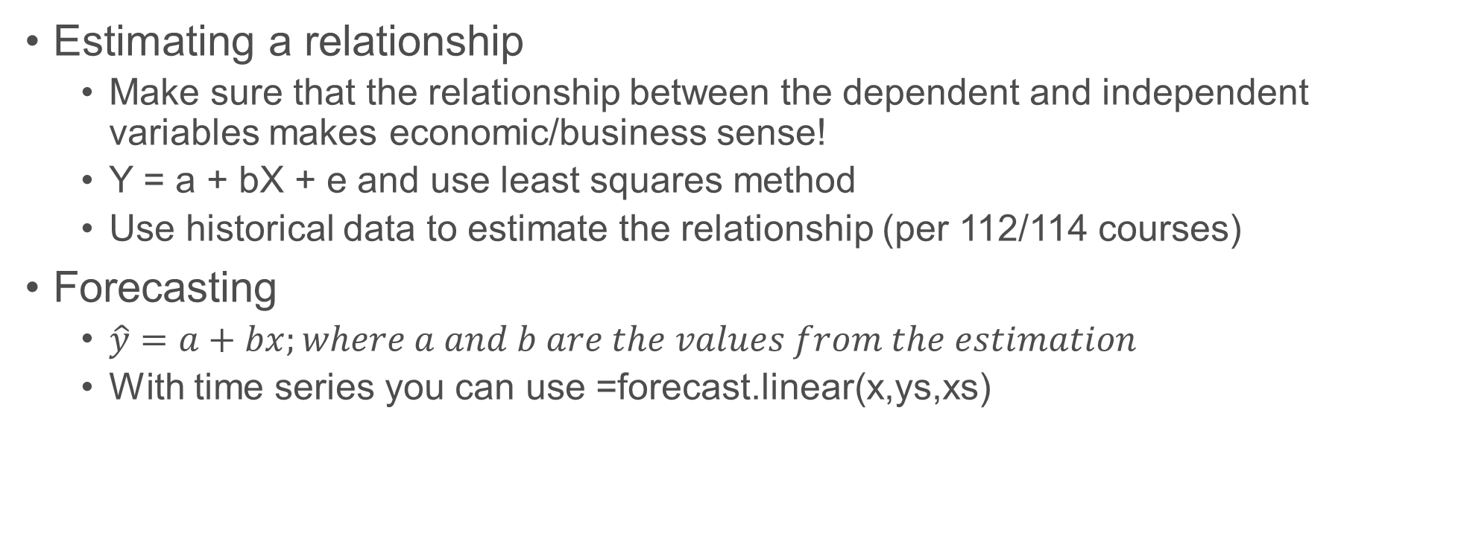
Linear Regression Forecasting
Estimating a relationship
Make sure that the relationship between the dependent and independent variables makes economic/business sense!
Y = a + bX + e and use least squares method
Use historical data to estimate the relationship (per 112/114 courses)
Forecasting
$\hat{y}=a+bx;where a and b are the values from the estimation$
With time series you can use =forecast.linear(x,ys,xs)

Slide 23
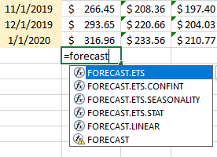

Linear Regression Forecasting – Part 2
So to forecast, we can use the forecast function. We will use linear and all data.
See the formula on the far lower left
The challenge is that we notice that this gives us the linear line starting at $233.93 because the stock popped recently

Slide 24
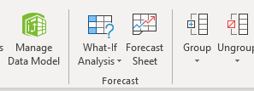
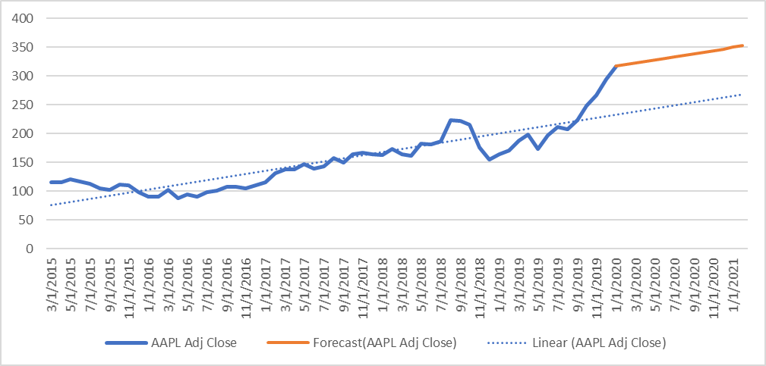
Linear Regression Forecasting – Part 3
Go into Excel and highlight your dates and APPL stock Price data.
Next go to the ‘Data’ tab → ‘Forecast Sheet’ icon.
This gives you a price forecast by excel for the future.
I do not show confidence intervals, but then added a trendline to the data.
Note Blue is last slide data and Orange adjusts for where the price is at now

Slide 25
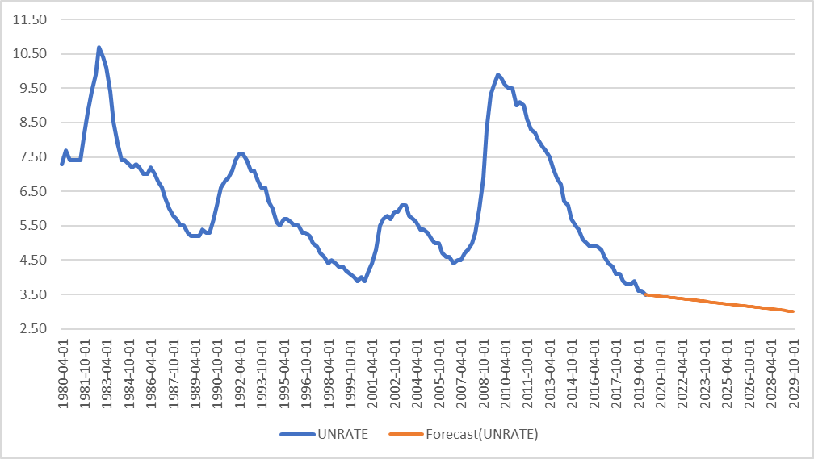
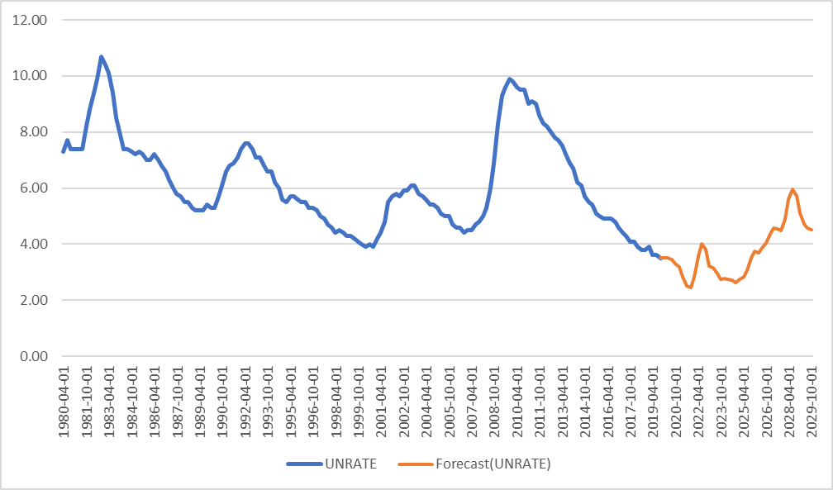
Linear Regression Forecasting – Part 4
Let us now use the unemployment data.
Gives an unemployment rate forecast by excel.
Notice again how it linear fits when adjusted to the most recent data point.
Lower chart if change seasonality to 48 months of data. Black box?

Slide 26
Multiple Regression Forecasting
Let us now use the full FRED data from earlier.
We generated estimates in excel.
Stock Price = $194.90 +10.09(T10Y2Y) -15.86(UNRATE) -0.054(HOUST).
We have to forecast those for next period. Let us use 1435 for April HOUST; 0.14 for T10Y2Y; 3.38% for UNRATE averaging the 2yr and 6yr models.
Estimate (y)=194.9+10.09*(.14)-15.86*(3.38)-.054*(1435)=$65.86
Stock now = $166.97 ------ >

Slide 27
Multiple Regression Forecasting
So this model has a nice R², but does not work economically it seems.
10Y – 2Y when it goes negative indicates a recession, more positive is stronger economy. Assume strong economy benefits stock price and weak hurts, as this approaches 0 or negative it should have same sign. This is +10 so good!
UNRATE when it goes smaller there are more people working so more people buying tool products and a higher stock price. So this should have an inverse relationship. This is -15 so good!
HOUST going up should generate more tool sales and be a positive impact on sales and the stock price. Uh oh – it is negatively correlated and significant. Or maybe they sell to homeowners and not professionals … recessions better???
This model seems misspecified. Maybe it would work with firm sales, but the stock price is a function of sales AND expenses. So this is not a good model and helps explain the issue.

Slide 28
Make sure models make economic sense!

Slide 29
Free Cash Flow Forecast
You must download historical pieces required of the FCF model (say Yahoo or SEC):
EBIT means forecasting ALL pieces of the income statement to that point
Increases in Working Capital means balance sheet items that are part of current asset and current liability accounts.
Capital expenditures means balance sheet items that are part of plant and equipment and are the change between two periods (net of depreciation).
NOPAT = EBIT (1-T)
Δ NOWC
Δ Net PPE
So, you need lots of downloads of data from Yahoo and SEC to then use to forecast every single piece …

Slide 30
Go through Example of FCF
Please open the file
“BUS391 – Week 06 – FCF Example – SP20”
We will walk through a simpler example that has embedded some sort of forecasted impact on various inputs that influence the FCFs.
This in turn will show us what happens to the stock price!

Slide 31
Excellent Modeling can be Challenging
Review Decision and Update
Model Makes Economic Sense
Historical Data Can be Found and Effectively Prepared to use in Python
You find an appropriate Forecasting technique to generate sound forecasts
USE qualitative judgements that are justifiable to augment your variable forecasted estimates
Implement your Model
Evaluate and Tweak
Make a Decision

Slide 32
Forecasting … you will now have even more fun!!

